Slide 1
Android Training Program
Basic Application Components

Slide 2
Application Components: Overview
The Android framework defines four types of application components that serve as the building blocks
of an Android application:
Activities
An activity represents a single screen with a user interface. Implemented as a subclass of Activity.
Services
A service performs some long-running operation in the background without a user interface. Implemented as a subclass of Service.
Broadcast Receivers
A broadcast receiver responds to system-wide broadcast announcements; they are the subscribers in Android’s publish/subscribe messaging pattern. Implemented as a subclass of BroadcastReceiver.
Content Providers
A content provider exposes a structured set of data to other applications through a database-like interface. Implemented as a subclass of ContentProvider.

Slide 3
Template Based Pattern
The component base classes follow the template method* design pattern.
The base classes define methods invoked by the system to interact with the component.
Most base class methods implement some default functionality.
Typically you would create subclasses of these base classes to define your application’s components, overriding the base class methods to implement custom functionality * http://en.wikipedia.org/wiki/Template_method_pattern

Slide 4
The Application Process
Applications have no main entry point (!)
When a new application is launched, Android will:
Create a new Linux process with the UID and GID of the app.
Initialize a new Dalvik VM instance.
Launches your application within the VM.
Android aggressively caches everything it can. So even destroying the Activity does not cause it to be completely destroyed immediately.

Slide 5
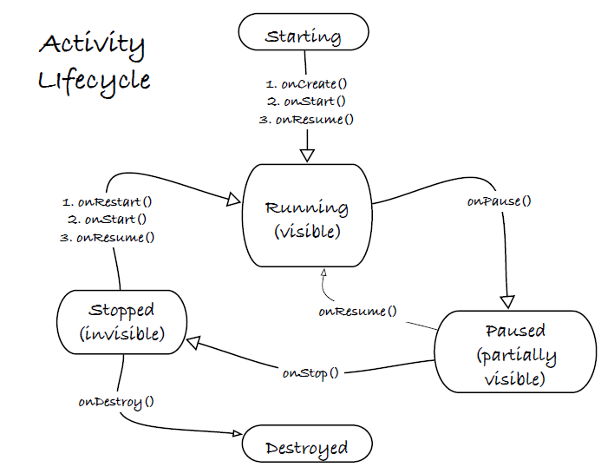
Activity Lifecycle

Slide 6
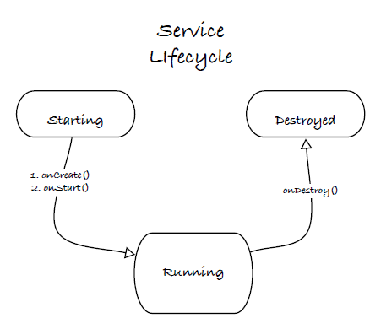
Service Lifecycle

Slide 7
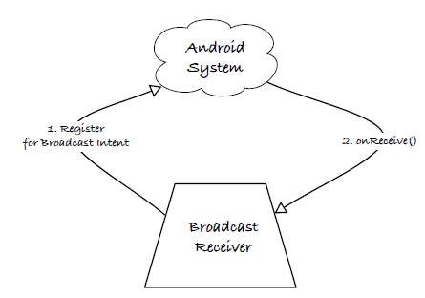
Broadcast Receiver Lifecycle

Slide 8
The Application Process Prioritization
Prioritization of apps (in descending order):
Foreground processes
The foreground activity (there can only be one)
Service/s marked as running in the foreground
A broadcast receiver executing onRecieve()
Visible activities
Any process that is not on the foreground BUT has one of more visible activities in pause state
Service Process
Any background service that is not marked as running in the foreground
Empty Processes
Any process with no active components

Slide 9
Intents
Think of them like HTTP requests in a web application (kinda).
All 4 component types are started via Intents
Intents are able to pass data between the 4 component types both ways.
All intents are subclasses of the Intent base class
Intents operate asynchronously (they do not block)
2 types of intents:
Implicit Intents
Explicit Intents

Slide 10
(Simple) Examples of Intents
startActivity(Intent) starts an activity and passes the Intent to the activity.
startService(Intent) starts a service and passes the Intent to the activity.
stopService(Intent) stops a service identified by the Intent.
sendBroadcast(Intent) delivers an Intent as a broadcast message to any broadcast receivers registered to receive it.

Slide 11
Broadcast Intents
Are designed to send broadcasts to processes that registered to ‘listen’ to that broadcast
The OS is able to send system-wide broadcasts to processes if something interesting happens, e.g.
“Hey, the user just connected to a WiFi network” (NETWORK_STATE_CHANGED_ACTION)
“Whoa, the user just put me into a dock” (ACTION_DOCK_EVENT)
“Oi, I’m running low on battery!” (ACTION_BATTERY_LOW) (sticky intent)
A single broadcast can activate multiple broadcast receivers on the phone
By default, if there are multiple receivers registered for an event, there is no order to which the system will activate each receiver (it often does it concurrently)

